Slide 1
Search content in this table. All columns expect 1st column are searchable.
Set number of entries per page
Click triangles to rank column
Retrieve corresponding results
Navigation bar
Delete the selected jobs

Slide 2
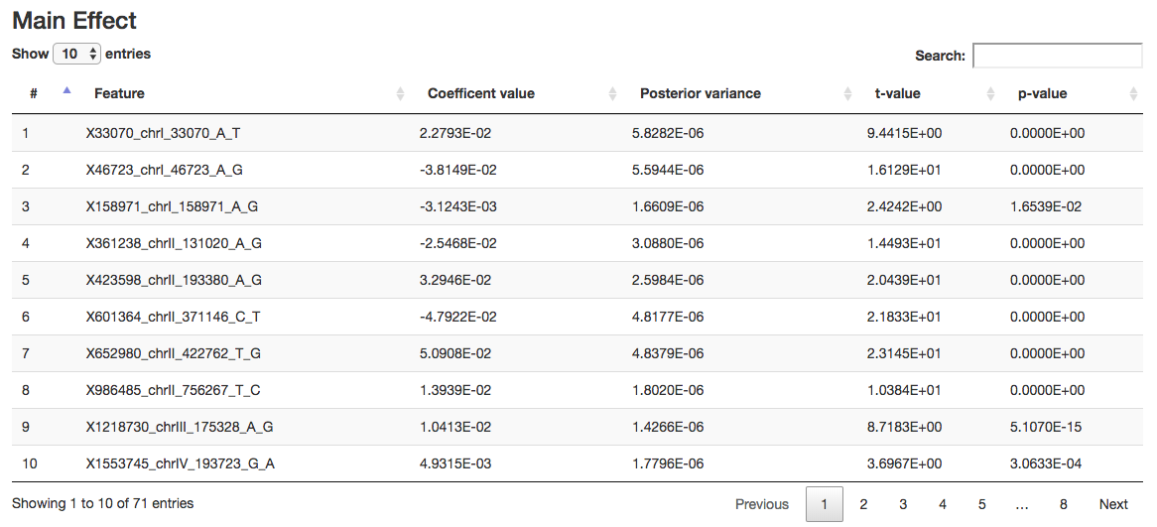
Set number of entries per page
Search content in this table. All columns expect 1st column are searchable.
Click triangles to rank column
Total results
Navigation bar

Slide 3
Schema with login
Parallel training different models
All user’s data will be kept private, except their shared models in repository. User can access their data after login website.
Model 1
Results & Visualization
Upload training data
Login
Submit a job
Model 2
Model 3
Shared models
Results & Visualization
Finished
Upload testing data
Select models from repository
Ongoing
Not start

Slide 4
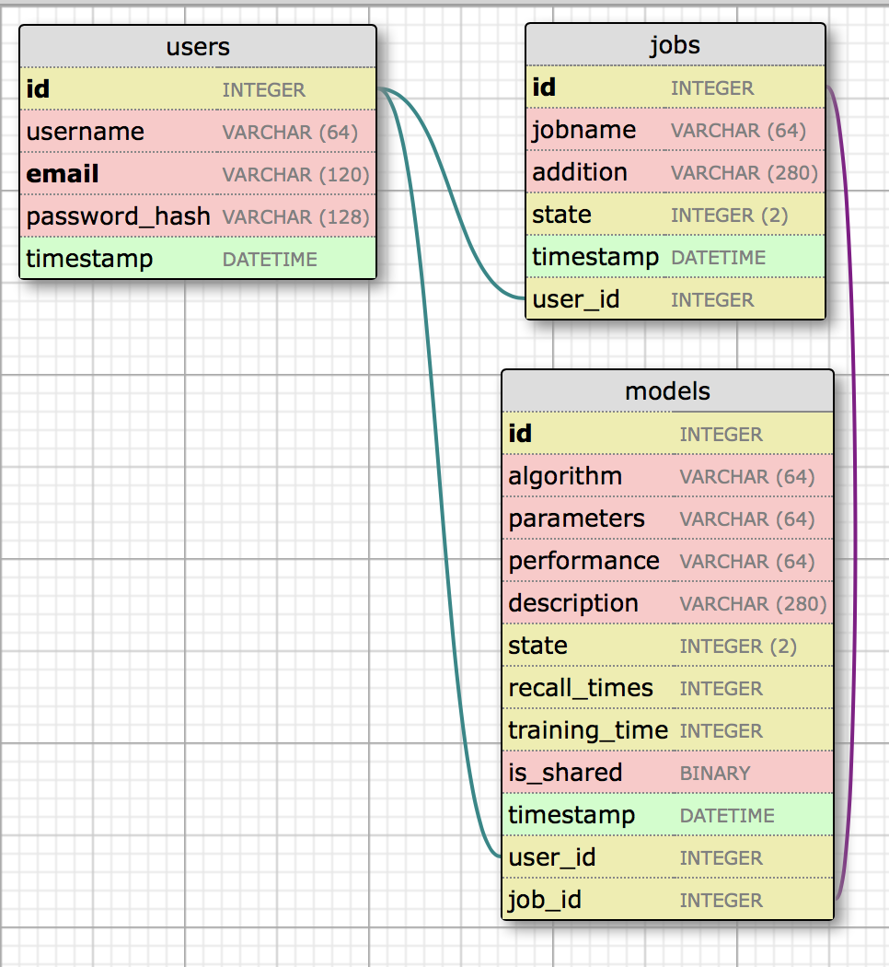
Database Relationship

Slide 5
Parallel training different models
Schema without login
All user’s data will be kept private. User can access their data via a specific URL link. Anyone can access their data via the same link.
We can set a security code to each user directory to increase the data safety.
Model 1
Upload training data
Security code request
Results & Visualization
Submit a job
Model 2
Model 3
Send a security code via an email
Select trained models
Model 3
Upload testing data
Security code request
Results & Visualization
Finished
Ongoing
Not start
Submit a job

Slide 6
Parallel training different models
Model 1
Upload training data
Security code request
Results & Visualization
Submit a job
Model 2
Model 3
Send a security code via an email
Select trained models
Model 3
Security code request
Upload testing data
Results & Visualization
Submit a job

Slide 7
Parallel training different models
Model 1
Upload training data
Security code request
Results & Visualization
Submit a job
Model 2
Model 3
Send a security code via an email

Slide 9


Slide 10






Slide 15
EpiML

Slide 16
EpiML

Slide 17
EpiML

Slide 18
EpiML

